Slide 1
Institute on the Biology of Aging
and Metabolism
Laura Niedernhofer, MD, PhD, Director
Paul Robbins, PhD, Associate Director

Slide 2
iBAM Mission
To improve the health, and thereby the quality of life, for the elderly in the state of Minnesota and beyond, through:
discovery of fundamental mechanisms that drive aging, the number one risk factor for the majority of debilitating chronic diseases.
drug development targeting these fundamental processes.
augmenting emerging approaches to clinically test therapeutics aimed to extend health span of the elderly.
educating the next generation of basic and clinical scientists dedicated to this mission.

Slide 3
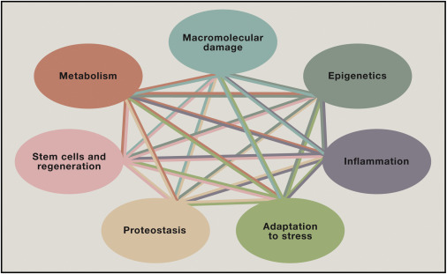
iBAM Goals
Recruit junior and senior investigators to UMN leading research in fundamental and translational geroscience.
Create a cohesive, collaborative and synergistic group of existing UMN investigators doing research on one or more of the pillars of aging.
Provide resources to facilitate and accelerate multidisciplinary research on aging, target and drug discovery, and translation.

