Slide 1
Memory Keepers Medical Discovery Team
Executive Director: Dr. J. Neil Henderson
Associate Director: Dr. Kristen Jacklin

Slide 2
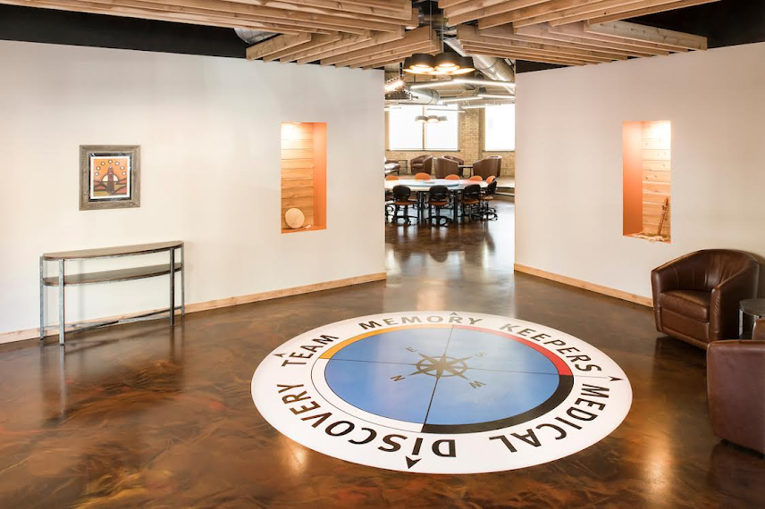
Memory Keepers Medical Discovery Team
Vision:
Advancing the boundaries of health equity research to create innovative interventions to support healthy aging in Native American and Rural populations.
Mission:
The mission of the Memory Keepers Medical Discovery Team is to support an environment of Team Science to conduct community-based participatory action research on diabetes and dementia in Native American and rural communities with the aim of achieving health equity
Entrance to Memory Keepers Collaborative Work Space
624 E 1st Street, Duluth, MN

Slide 3
Elder Advisory Council
Rural Research Advisory Council
TBD
Structure and Activities (September, 2020)
Memory Keepers Medical Discovery Team
Admin. Associate
Tracy Kemp
Director
J. Neil Henderson, PhD
Associate Director
Kristen Jacklin, PhD
Director, Rural Health Initiatives
Wayne Warry, PhD
Elder in Residence
Rick Smith, MEd
Research Activities & Support
Indigenous Cultural Understandings of Alzheimer’s Disease and Related Dementias-Research and Engagement (ICARE)
Dementia Caregiver Mastery with Reminiscence Therapy and Traditional Foods
Center for Community Engaged Rural Dementia and Alzheimer's Research (CERDAR)
Education Activities & Support
Honoring Elder Wisdom Conference
Alzheimer’s Association and the Centers for Disease Control and Prevention (CDC) nationally distributed the new Road Map for Indian Country monograph on dementia
Savvy Caregiver in Indian Country
Canadian Indigenous Cognitive Assessment (CICA)
Indigenous Cognition & Aging Awareness Research Exchange
Community Activities & Support
Giiwedinong Committee – Northwoods Caregivers, Minnesota Chippewa Tribes (Henderson & Jacklin committee membership)
Tribal Resolutions from the Minnesota Chippewa Tribal Executive Committee, Grand Portage Band of Lake Superior Chippewa and Red Lake Nation
White Earth Nation Research Permit

Slide 4
Contact Us
Memory Keepers Medical Discovery Team
University of Minnesota Medical School
624 E. First St. Suite 201 Duluth, MN 55805
218-726-6801
memorykeepers@d.umn.edu

