Slide 1
Minnesota Northstar
Geriatrics Workforce Enhancement Program (MN GWEP)
Notes:
Take about 15 minutes to summarize my impressions of the department and some ideas of where we should go in the future. Most of this is repetition from application presentation. After this, I want to have a little Q and A and then engage everyone in some brainstorming related to where we want to go.

Slide 2
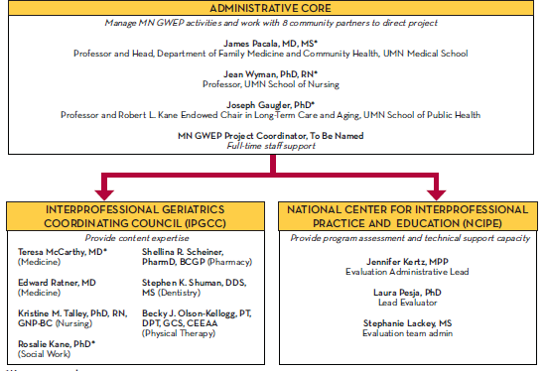
Notes:
Early in 20th century, research performed mostly by individuals; gov’t research in gov’t labs
Arrowsmith was model
“Then in the 1940s, there was a major world event. What was it?”

Slide 3
